Slide 1

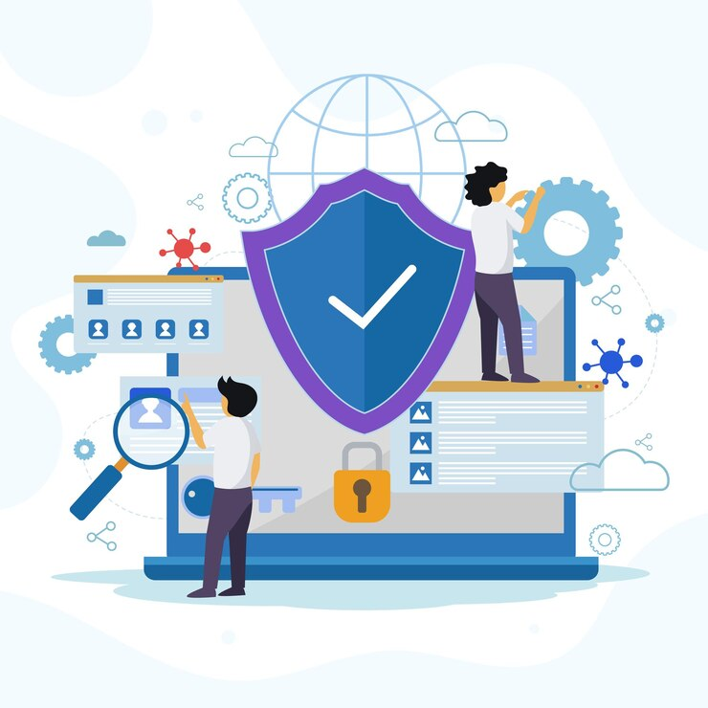
Infrastructure & Security Awareness
Understanding Secure Infrastructure in DevOps
1

Slide 2
Session Agenda
01
02
What is Infrastructure?
Infrastructure as Code (IaC)
03
04
Security in DevOps
Real-World Security Incidents
05
06
Security Layers & Firewall Basics
YAML Config & Risk Identification
2

Slide 3
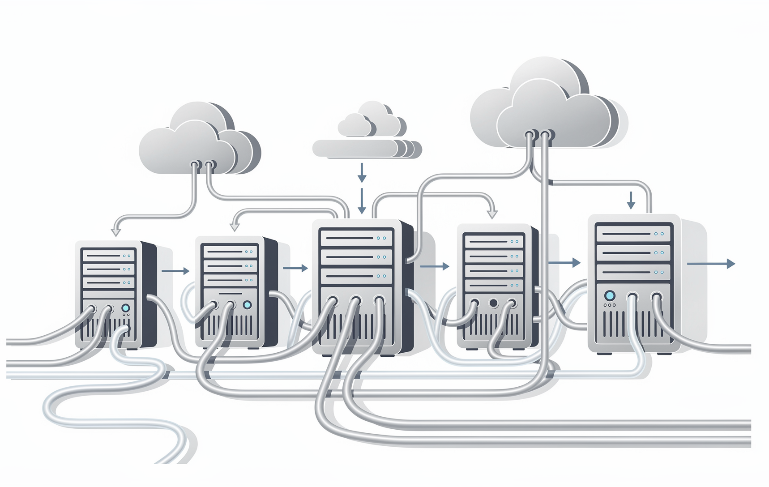
CONCEPT INTRODUCTION
What is Infrastructure?
Infrastructure is the foundation that runs applications. Without it, apps cannot function.
Servers
Networks
Storage
Databases
Load Balancers
Cloud Resources
3

Slide 4
Traditional vs Cloud Infrastructure
Traditional
Cloud Infrastructure
Physical servers
Manual configuration
Slow provisioning
Virtual machines
Automated setup
On-demand provisioning
Infrastructure is now programmable.
4

Slide 5

INFRASTRUCTURE AS CODE
What is Infrastructure as Code?
IaC means managing infrastructure using code instead of manual setup. Instead of manually creating servers, write configuration files to create them automatically — consistently and repeatedly.
5

Slide 6




Benefits of IaC
Consistency
Version Control
Same environment every time — no configuration drift.
Track changes to infrastructure just like application code.
Faster Provisioning
Reduced Human Error
Spin up environments in minutes, not days.
Automated setup eliminates manual mistakes. Integrates with CI/CD pipelines.
6

Slide 7

YAML Configuration Example
Key Concepts
server:
name: web-server
instance_type: t2.micro
region: ap-south-1
security_group:
allow_http: true
allow_https: true
Declarative Approach
Describe what you want, not how to build it.
Reusable Config
Infrastructure defined as files — reuse across environments.
Version Controlled
Store in Git for full audit trail and rollback.
7

Slide 8

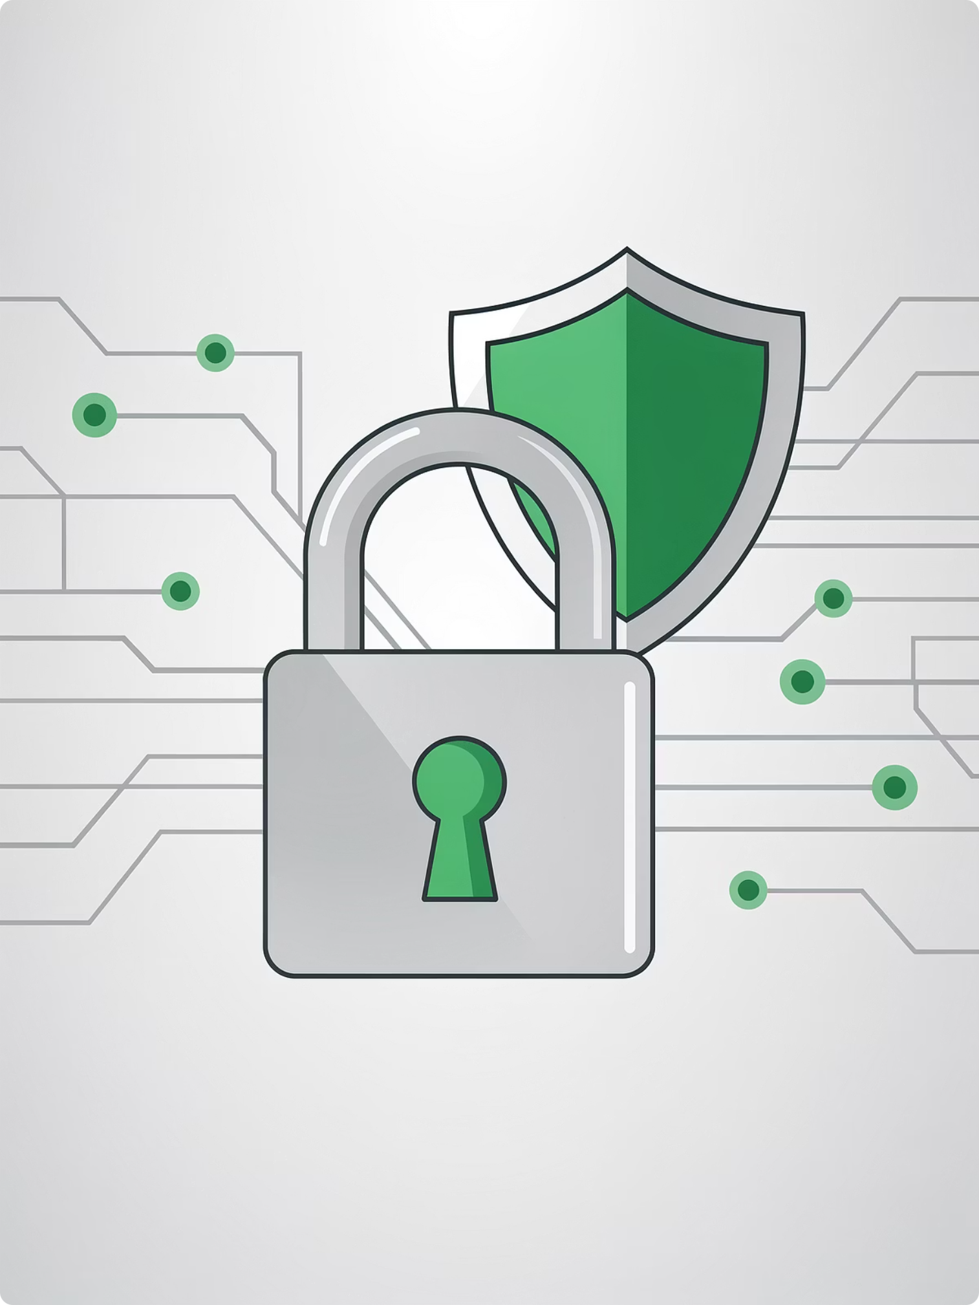
SECURITY IN DEVOPS
Why is Security Important in DevOps?
Applications exposed to the internet face constant threats. Security must be integrated early — the DevSecOps mindset.
Data Theft
Unauthorized Access
Malware Attacks
Service Disruption
8

Slide 9
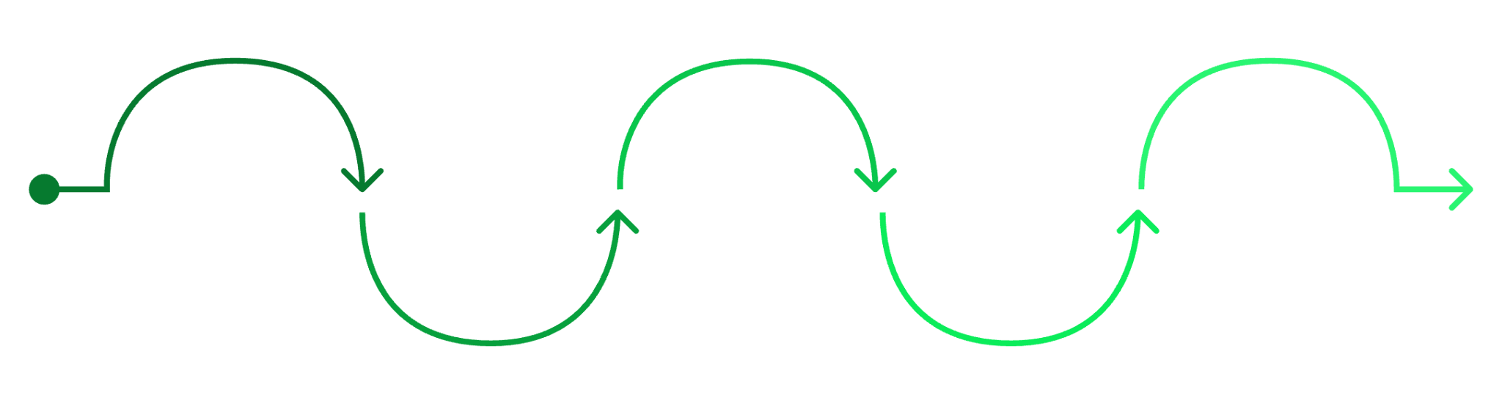

Shift Left Security
Security is Everyone's Responsibility
Traditional
Development
Build
Deployment
Monitoring
In modern DevOps, security is not a final checkpoint — it's woven into every stage of the pipeline.
Security at the end of pipeline
Secure coding and peer reviews
Automated SAST and dependency scans
Infrastructure as code checks
Continuous runtime detection
The earlier a vulnerability is caught, the cheaper and easier it is to fix.
9

Slide 10
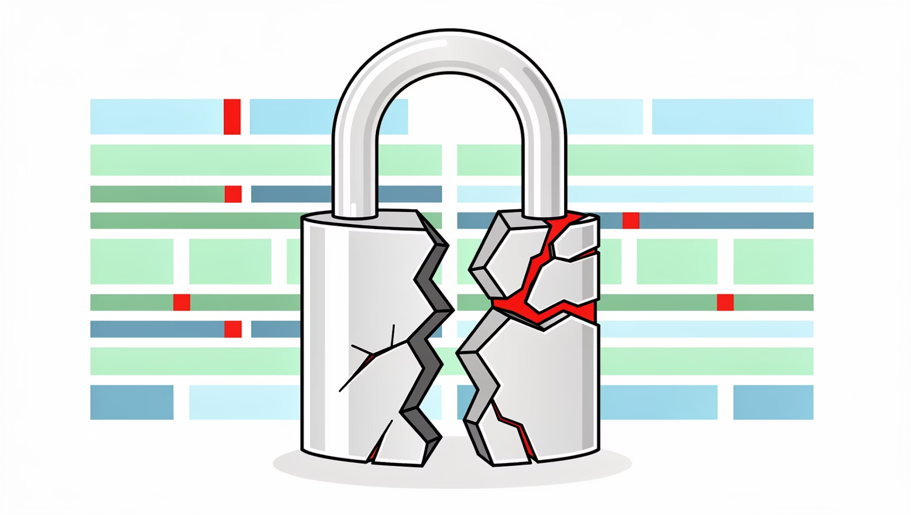
REAL-WORLD EXAMPLES
Data Breach Scenario
Scenario
Company stores user data without encryption.
Result
Data leaked
Financial loss
Reputation damage
Lessons
Encrypt sensitive data
Enforce access control
Conduct regular audits
10

Slide 11
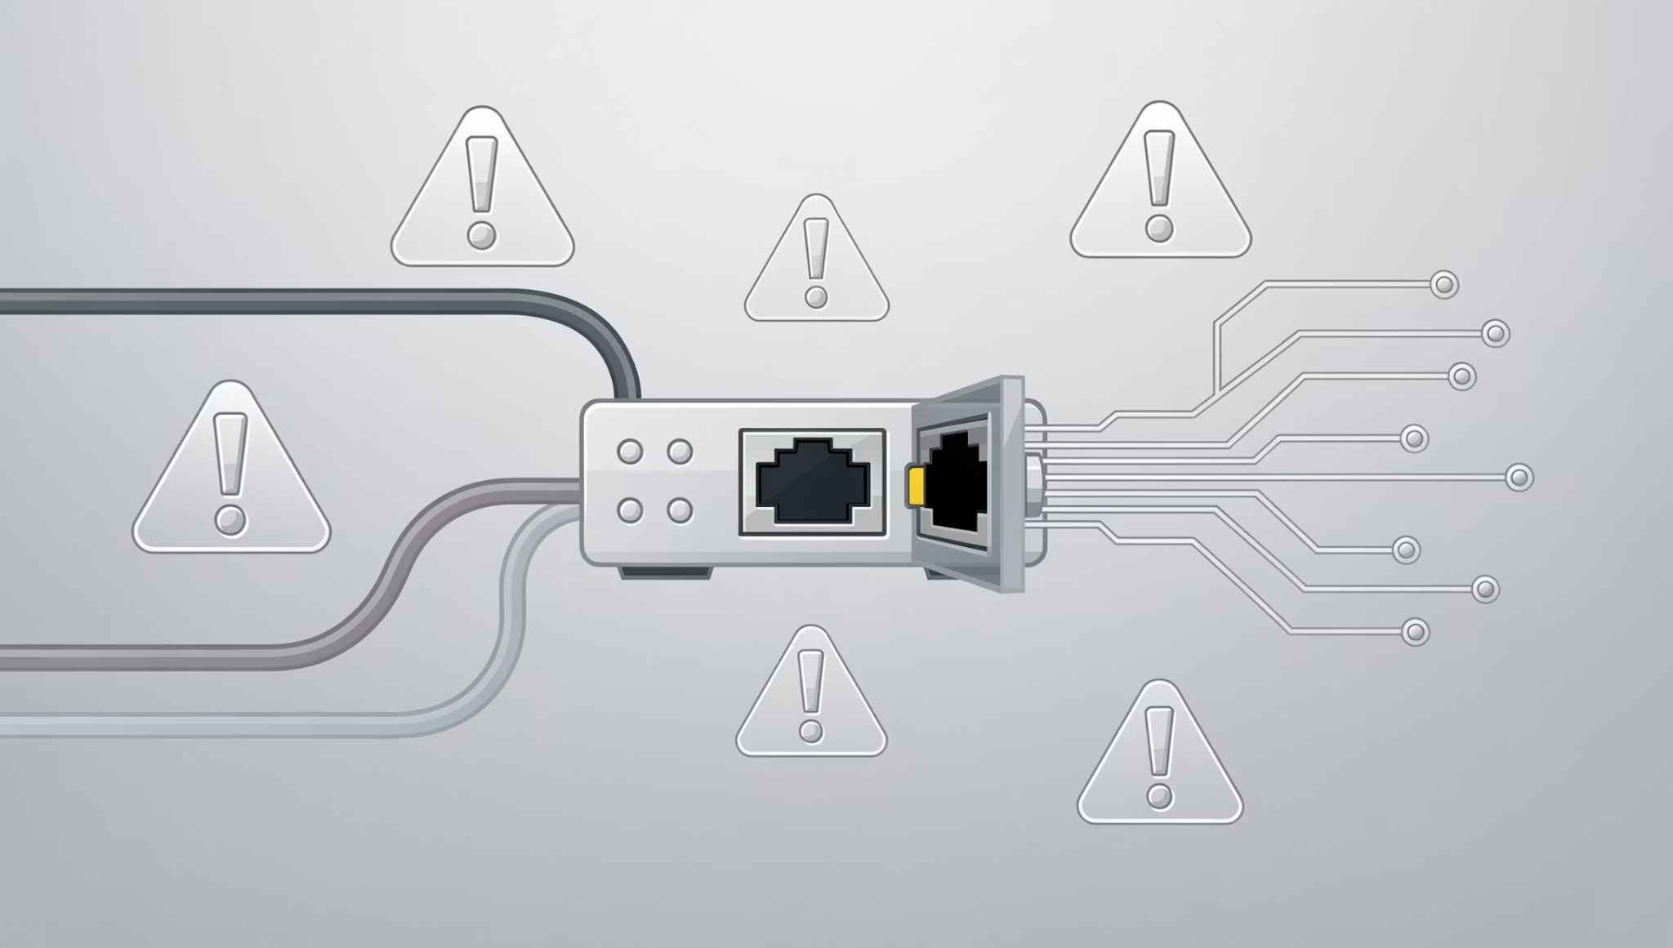
Misconfigured Server
Scenario
Server accidentally exposed to the public internet. Port 22 (SSH) open to all.
Risk
Brute force attacks
Unauthorized access
Lesson: Always configure firewall rules carefully. Restrict SSH to known IP ranges only.
11

Slide 12



DDoS Awareness
Attack
Impact
Prevention
Massive traffic sent to overwhelm servers
Service becomes unavailable — disrupts users
Load balancers, rate limiting, CDN, auto scaling
DDoS = Distributed Denial of Service. Goal: disrupt availability.
12

Slide 13
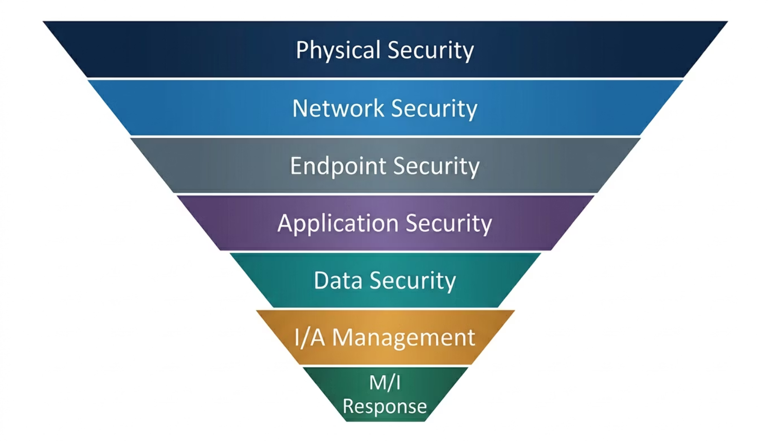
SECURITY LAYERS
Defense in Depth
Layered security ensures that if one layer fails, others still protect the system. No single point of failure.
This is the Defense in Depth concept — a core principle of secure architecture.
13

Slide 14
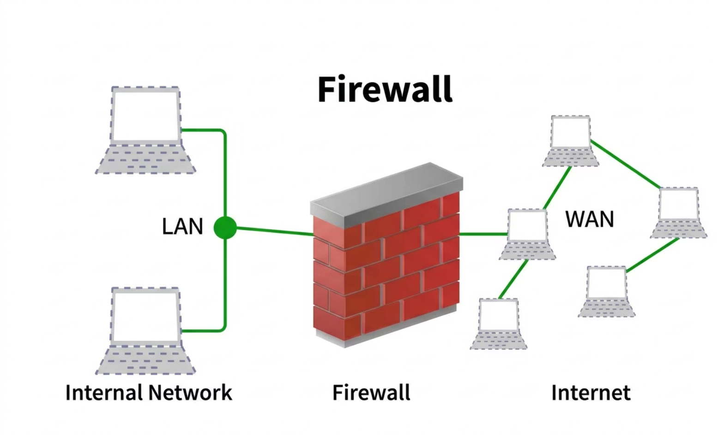
Basic Firewall Concept
What a Firewall Does
Controls incoming & outgoing traffic
Blocks unauthorized access
Allows specific ports only
Example Rules
Allow
Block
Port 80 (HTTP)
All other ports
Port 443 (HTTPS)
14

Slide 15
INFRASTRUCTURE + SECURITY TOGETHER
Secure Infrastructure Design
Private Subnets
Public Load Balancer
Restricted SSH
Internal resources hidden from public internet
Single controlled entry point for traffic
Access limited to trusted IP ranges only
DB Not Public
Monitoring & Alerts
Database never directly accessible from internet
Continuous visibility into system behavior
15

Slide 16
DEMO
YAML Security Rule Example
Principle of Least Privilege
security_group:
inbound_rules:
- port: 80
source: 0.0.0.0/0
- port: 443
source: 0.0.0.0/0
- port: 22
source: 192.168.1.0/24
HTTP/HTTPS Public
Ports 80 & 443 open to all — necessary for web traffic.
SSH Restricted
Port 22 limited to internal subnet 192.168.1.0/24 only.
16

Slide 17

Identify Security Gaps
Example Architecture
What security controls are missing from this setup?
User
External client without authentication
Firewall
Encryption
Unprotected Three‑Tier Flow
Backup
Monitoring
Database
Web Server
Unencrypted, no backups or monitoring
No firewall or input validation
17

Slide 18

DATA IN TRANSIT VS AT REST
Encryption Basics
Protect data even if intercepted or stolen?
Data in Transit
→ HTTPS / SSL/TLS
→ Protects data while traveling
Data at Rest
→ Disk encryption
→ Database encryption
18

Slide 19
SCENARIO DISCUSSION
Security Checks Checklist
Strong Passwords & MFA
Encrypted Data (HTTPS)
Firewall Rules
Multi-factor authentication on all accounts
All data in transit and at rest encrypted
Restrict ports to only what's necessary
Patch Updates & Backups
Monitoring & RBAC
Regular updates and tested backup strategy
Alerts for anomalies + role-based access control
19

Slide 20

Group Risk Identification Activity
Scenario: E-commerce application architecture. Each group identifies:
Security Risks
Infrastructure Risks
Possible Improvements
20

Slide 21
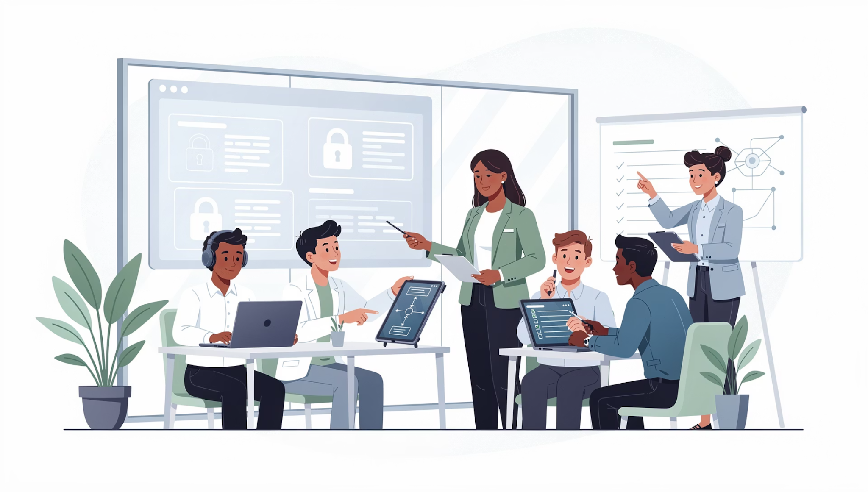
DevOps + Security Culture
Secure systems are built, not added later.
Security is not only the security team's job. It is:
Developer's responsibility
Operations responsibility
Shared accountability across all roles
21

Slide 22
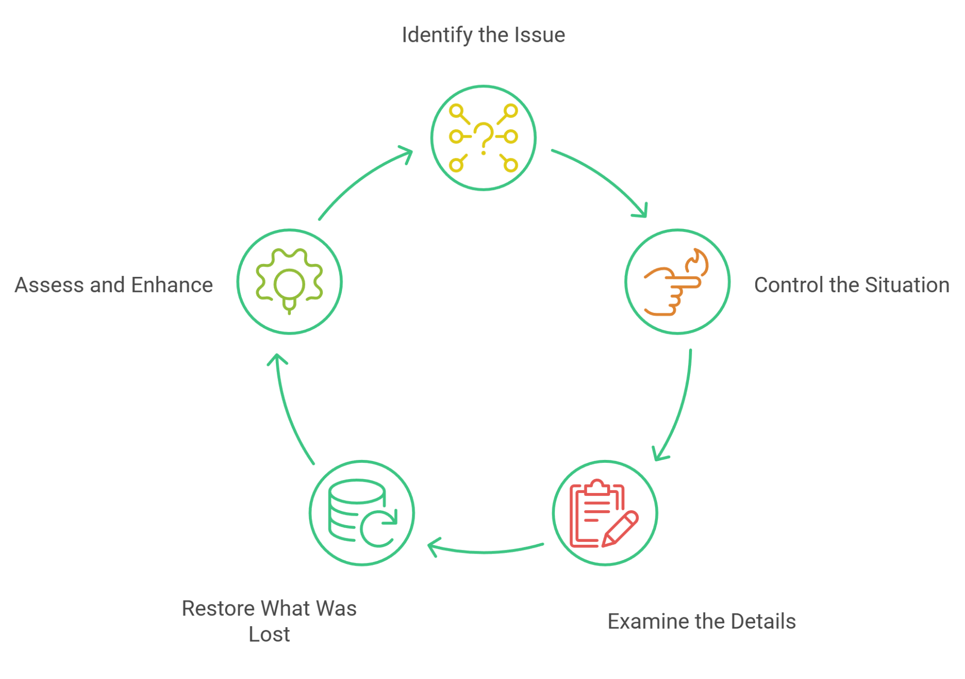
Security Incident Response Basics
When security incident occurs:
Have a response plan before the incident happens.
22

Slide 23
Security Monitoring Checklist
Monitor:
✅ Failed login attempts
✅ Unusual traffic spikes
✅ Unexpected file changes
✅ Configuration changes
✅ Unauthorized access attempts
✅ Suspicious IP addresses
✅ Expired SSL certificates
Key Takeaway: Security is continuous monitoring, not one-time setup.
23

Slide 24
Key Takeaways
1
Infrastructure Foundations
Servers, networks, storage, and cloud resources power every application.
2
Infrastructure as Code
Consistent, version-controlled, automated provisioning.
3
Security in DevOps
Data breaches, misconfigurations, and DDoS are real threats — shift left.
4
Secure Architecture
Firewall rules, private subnets, least privilege, and monitoring are essential.
5
Risk Identification Mindset
Always ask: what's missing? Security is everyone's shared responsibility.
24

Slide 25


Thank You
25

